Slide 1
Text Mining on Social Media
Yizhao Ni
4/18/2014
Division of Biomedical Informatics
Cincinnati Children’s Hospital Medical Center

Slide 2
Reference
Myslín M, Zhu SH, Chapman W, Conway M. Using twitter to examine smoking behavior and perceptions of emerging tobacco products. J Med Internet Res. 2013 Aug;15(8):e174.
Chary M, Genes N, McKenzie A, Manini AF. Leveraging social networks for toxicovigilance. J Med Toxicol. 2013 Jun;9(2):184-91.
Sanders-Jackson A, Brown CG, Prochaska JJ. Applying linguistic methods to understanding smoking-related conversations on Twitter. Tob Control. 2013 Nov. doi:10.1136/tobaccocontrol-2013-051243. [Epub ahead of print]
Prier K, Smith M, Giraud-Carrier C, Hanson C. Identifying health related topics on Twitter: an exploration of tobacco-related tweets as a test topic. In proc. of the 4th international conference on Social Computing, Behavioral-Cultural Modeling and Prediction. 2011;18-25.
Hu X, Liu H. Text analytics in social media. Mining Text Data, Springer. 2012; 385-414.
Etc……

Slide 3
The Big Picture

Slide 4
ESP
Chopper
*Santa NOT included

Slide 5
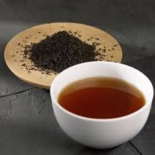
ESP
Tea

Slide 6
Social Medial Language

Slide 7
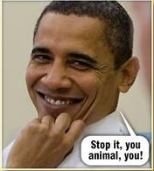
Social Media Language
Pros
Deeeeeeeep source of data
Rapidly updating (200M tweets per day)
Freely available and unlimited use*
Cons
Slang, regional dialects, acronyms, misspelling…
Untested
No precedent in the medical literature
Results might not be generalizable
*Terms and conditions do apply

Slide 8
Workflow

Slide 9
Software API
https://developers.google.com/+/api/?hl=zh-en
https://developers.facebook.com/docs/graph-api/
https://dev.twitter.com/docs/api/1.1
https://developer.linkedin.com/apis

Slide 10
Software API
Access authorization
Which application accesses the data?
User agreement or public content
Access which data?
Data extraction
Twitter4J: http://twitter4j.org/en/index.html

Slide 11
NLP – Natural Language Understanding
Porter Stemmer
Stanford POS Tagger
Stanford Parser
NJ residents want legalized
tea
more than legalized online gambling
JJ
NN

Slide 12
NLP – Term Level Analysis
Remove stop words
E.g. “the”, “to”, “also” etc
Rule-based feature extraction
Strict keyword search: e.g. “pot”, “tea”, “weed” etc
Minimum length word constraint
Statistical analysis
Prune the least frequent words
Term frequency $tf\left(t,d\right)=0.5+\frac{0.5×f(t,d)}{max⁡\{f\left(w,d\right):w∈d\}}$
Inverse document frequency $idf\left(t,D\right)=log\frac{N}{|\{d∈D:t∈d\}|}$

Slide 13
NLP – ngram
A contiguous sequence of n words
E.g. “legalized tea”, “Japanese tea”, etc
Capture statistical relationships
Used to identify a sequence of words co-occur unusually often
Help identify similar concepts, e.g. the distribution of “legalized tea” < “Japanese tea” ≈ “Chinese tea”
Require a large amount of data
Distant (gap) n-gram
E.g. “Do you think what you think you think”?
Used to cover long-range dependency
Usually accompanied by dependency parser
Polynomial computational complexity

Slide 14
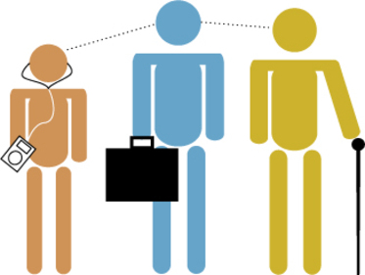
NLP – Document Level Analysis
Lexical diversity
LD=$\frac{|unique words in the document|}{|total number of words|}$
Lempel-Ziv complexity
LZC=$\frac{|unique phrases in the document|}{|total number of phrases|}$
Data compression algorithm
Vector space model
Algebraic model for representing text documents
Integrate other techniques such as ngram and TF-IDF

Slide 15
Machine Learning

Slide 16
Supervised Learning – Binary Classification
NJ residents want legalized tea more than legalized online gambling
vegetable, healthy living, anti-aging
weed, tea, cannabis, smoke, hookah, JB

Slide 17
Supervised Learning – Binary Classification
Naïve Bayes
Basic probabilistic classifier
http://www.cs.cmu.edu/~tom/mlbook/NBayesLogReg.pdf
Logistical regression
With L1 regularization (LASSO) for feature selection
https://homes.cs.washington.edu/~suinlee/publications/l1logreg-lee-aaai06.pdf
Support vector machine
Linear discriminant
http://www.cs.cornell.edu/people/tj/svm_light/svm_perf.html

Slide 18
Supervised Learning – Multiclass
Multi-class
E.g. classifying a social media user into high-risk, moderate risk or low-risk of substance abuse (3-class classification)
SVM extension strategy: one-vs-one, one-vs-all (rest)
One-vs-all strategy: construct M SVMs and
choose
1,2,3
One-vs-one strategy: construct M(M-1)/2 SVMs
and choose the one that wins the majority vote.
To be continued…
Notes:
analysis.

Slide 19
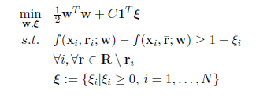
Supervised Learning – Multi-label
Multi-label (Multi-output)
E.g. predicting the use of alcohol, tobacco and drug use for a social media user [alcohol, tobacco, drug]=[1,0,1]
Also model the correlation between the outputs (e.g. drug users tend to consume alcohol)
SVM extension strategy: Hamming loss, dependency distance
Kernel canonical correlation analysis (KCCA)
1,1,0

Slide 20
Feature Selection
Supervised
Chi-square test
Pearson correlation, Spearman’s rank correlation
Information gain, IG ratio, mutual information (KL divergence)
Unsupervised
Principle component analysis (PCA) $X=UW$
Singular value decomposition (SVD) $X=UΣV$
Useful for grouping correlated features, but don’t know which group contributes to which class

Slide 21
Unsupervised Learning – Topic Clustering
Objective(s)
Group the documents and identify the underling topics
E.g. finding common tobacco-related themes
Methodology
Calculate similarity between documents
Cluster the documents based on the similarity scores
Manual inspection of the clusters to identify the topics
Algorithms
K-nearest neighbors (KNN)
Hierarchical clustering/K-means
Latent Dirichlet Allocation (LDA)

Slide 22
Unsupervised Learning – User Grouping
Hypothesis
Individuals are more likely to connect with one another if they share common interests.

Slide 23
Unsupervised Learning – User Grouping
Methodology
Bayesian networks (e.g. undirected graphic model)
Belief propagation
Determine clique potentials
Manual inspection

Slide 24
Myslín M, Zhu SH, Chapman W, Conway M. Using twitter to examine smoking behavior and perceptions of emerging tobacco products. J Med Internet Res. 2013 Aug 29;15(8):e174.

Slide 25
Thank You

