Slide 1
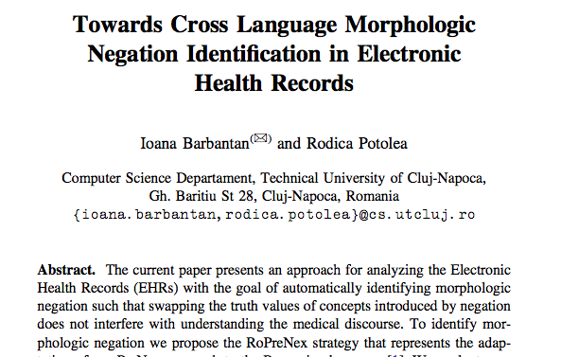
Ioana Barbantan and Rodica Potolea

Slide 2
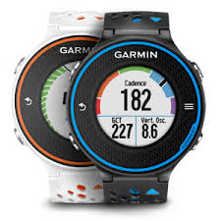
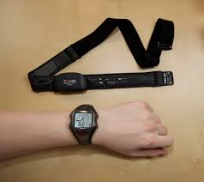
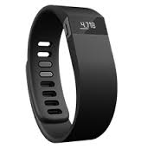
Lots of technology to capture health information.

Slide 3
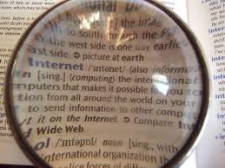
What happens when the device’s native language is not the speaker’s native language?

Slide 4
Goal
Identifying negation in the EHR, towards retrieving relations among medical concepts.
Adapting Romanian based on established English methodology.

Slide 5
Basic methods
Interpreting the structure of the words and evaluating existence of the words with and without prefix in the language.

Slide 6
Morphologic negation
indicated by prefixes such as in-, im-, il-, dis-, un- or by the suffixes –less, and –out (eg, without)
Negation, Text Worlds, and Discourse: The Pragmatics of Fiction
By Laura Hidalgo-Downing

Slide 7
Medical Records
Expectation that negative prefixes are broadly used and negation is clearly formulated as the EHR should be clear and as few ambiguous terms as possible

Slide 8
Negation in medical records
There are lots of ways to say the same thing
Eg
The patient has no symptoms. (syntactic negation)
The patient is asymptomatic. (Morphologic Negation)
The patient doesn’t have symptoms. (syntactic negation)

Slide 9
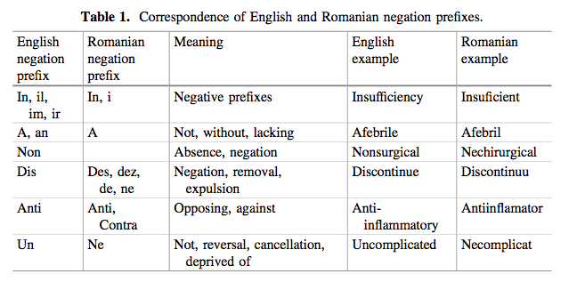
Morphologic Negation

Slide 10
Goal: Source language (English) to target language (Romanian)
Instantiate cross language methodology that identifies morphologic negation in both the source and target languages
Task: Negation identification in EHRs

Slide 11
Dataset
EHRs available in English
Semi-structured documents
Inpatient
Contains symptoms, history, procedures, medications
1. Translate into Romanian using online translation service.
2. Use a dictionary-based approach to identify morphologic negation

Slide 12
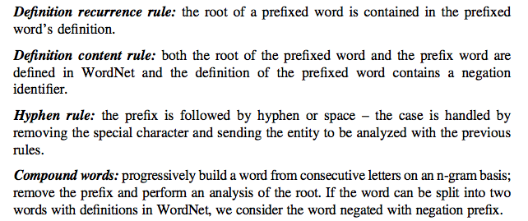
Rules for negation identification

Slide 13
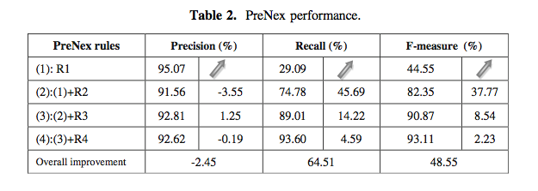
Notes:
Rules added progressively

Slide 14
Proposed methodology
Notes:
Amount of annotated EHRs is not satisfactory for a reliable analysis (Romanian)
Words that didn’t translate (nontender, nonfasting)

Slide 15
RoPreNext Algorithm
Considers words with Romanian dictionary online
The dictionary interlinks the words with their definitions (and has integrated synonyms)
Included an additional verification step (for regional/rural expressions)

Slide 16
Lemmatization process
For each word that is a possible negated concept,
Remove prefix and preprocess
If a match with the preprocess and the dictionary,
Send to the negation identification rules

Slide 17
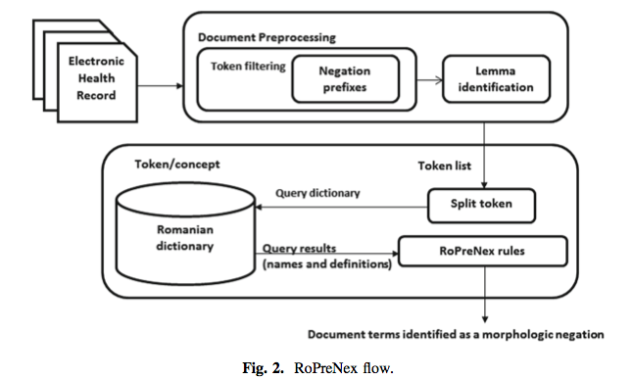

Slide 18
Morphologic negation rules
Literal words: preprocessing step applied for words in the dictionary
Definition content: identifies negation based on the definition.
Undefined prefix word: word not defined in the dictionary (and could be domain specific).

Slide 19
Experiments

Slide 20
Rules coverage
Notes:
Most concepts identified by definition concept rule

Slide 21
Notes:
prenex Outperforms roprenex strategy only marginally (table 5)

Slide 22
Notes:
I

Slide 23
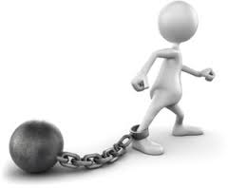
Limitations
Translated documents
Not one-on-one translation
Did not include any language-specific methodologies for text analysis
Word-level issues
Root structure changes not caught
Dictionary level issues
May not have specialized terms (atraumatic)

Slide 24
Conclusions
Reliable
False-positives are not medical-related concepts
Future work
Will first spell-check documents
Look into abbreviations

Slide 25
Questions
How can we apply this?
Could it be used for additional languages?

