Slide 1
Best-of-Breed
Hybrid Methods for Text De-identification
Yang H, Garibaldi JM. Automatic detection of protected health information from clinical narratives. JBI. 2015;http://dx.doi.org/10.1016/j.jbi.2015.06.015
Dehghan A, Kovacevic A, Karystianis G, et al. Combining knowledge- and data-driven methods for de-identification of clinical narratives. JBI. 2015;http://dx.doi.org/10.1016/j.jbi.2015.06.029

Slide 2
Text De-identification
Introduction
Remove Protected Health Information (PHI) from clinical notes
HIPPA PHI Categories (18 specific identifiers)
NAME
LOCATION (all geographical identifiers smaller than a state)
DATE (e.g., birth date, admission date, discharge date)
AGE*
ID (SSN, MRN, Insurance number, Account/license number)
CONTACT (Phone, Fax, Email, URL, IP address)
Date of Admission: <DATE>11/11/2011</DATE>. Assessment: <NAME>John Smith</NAME> is a <AGE>3 yo</AGE> male with concern of hypoglycemia ......
Notes:
Narrow scope
2

Slide 3
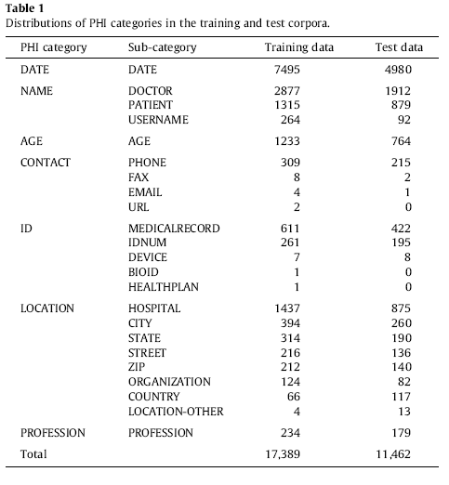
Descriptive Statistics of i2b2 data
Notes:
3

Slide 4
Text De-identification
Introduction
Growing adoption of Electronic Health Records (EHRs)
Increased emphasis on the re-use/sharing of clinical data
A large amount of data are in unstructured format
Health Insurance Portability and Accountability Act (HIPPA)
Notes:
4

Slide 5
Problem Statement
Problem Statement
Date of Admission: 11/11/2011. Assessment: John Smith is a 3 yo male with concern of hypoglycemia ......
Date of Admission: <DATE>11/11/2011</DATE>. Assessment: <NAME>John Smith</NAME> is a <AGE>3 yo</AGE> male with concern of hypoglycemia ......
Date of Admission: <DATE>01/01/2001</DATE>. Assessment: <NAME>Jackie Chen</NAME> is a <AGE>12 yo</AGE> male with concern of hypoglycemia ......
Notes:
5

Slide 6
Literature
Notes:
6

Slide 7
Conceptual Model
Conceptual Model
Notes:
7

Slide 8
Text Pre-processing
Text Pre-processing
Tokenization (special): 3041023MARY -> MRN+Hospital
3yo -> 3 yo
Doc-level feature: Only process text from certain sections (e.g., delete
the “Medication” section in discharge summary)
Both tasks are rule-based and require manual design of the regular expressions.
Notes:
8

Slide 9
PHI Term Identification
PHI Term Identification
Notes:
9

Slide 10
ML-based Tagger
Conditional Random Fields
(McCallum, 2002)
Notes:
Maximize conditional probabilities.
10

Slide 11
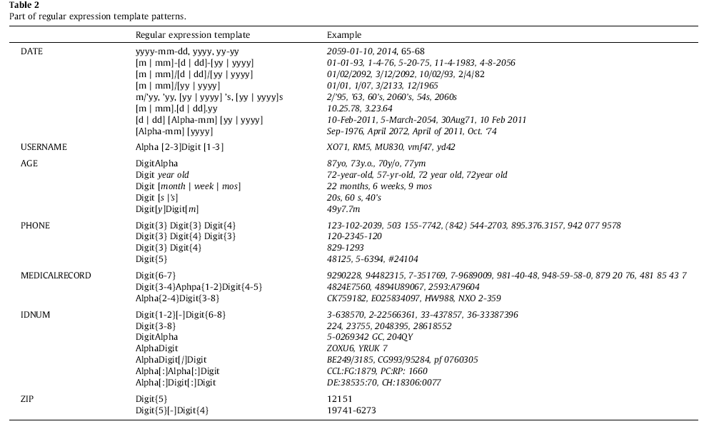
Rule-based Tagger
Notes:
11

Slide 12
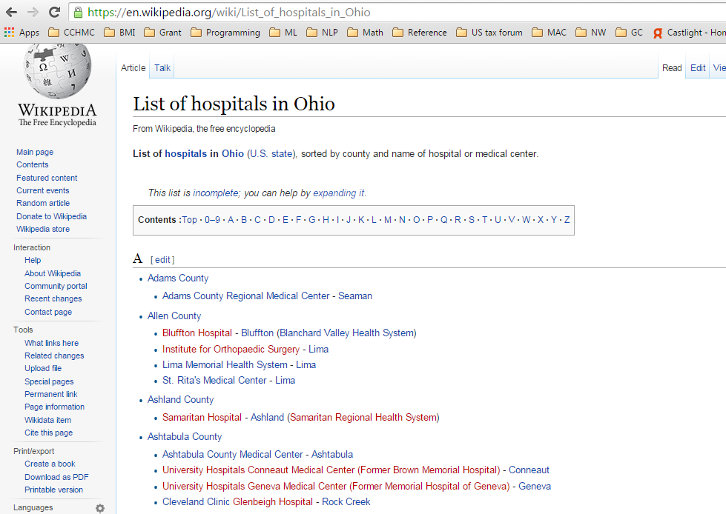
Dictionary-based Tagger
Notes:
12

Slide 13
Feature Extraction
Feature Extraction
Feature Definition
Notes:
13

Slide 14
Example Features
Feature Extraction
Example Features
Notes:
Lemma = Canonical form
14

Slide 15
Post-processing
Post-processing
Token-level entity extraction: 3041023MARY -> MRN+Hospital
Co-reference: “John Smith” ↔ “J. Smith”. Co-reference relations were predicted by the adapted co-reference resolution system
Name permutation: “John Smith” → {“John”, “Smith”, “Smith, John”, “J. Smith”, “John Smith”} (also applied to the hospital category)
Longitudinal search: if “Dr. Hutton” appeared in one patient record, it was likely to appear in the patient’s other records
Notes:
15

Slide 16
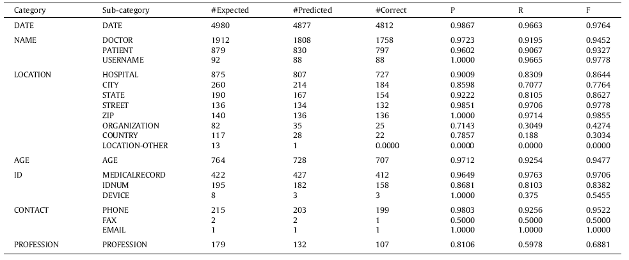
Performance (U. Nottingham)
Performance
Achieved the best performances on most of the categories
Notes:
16

Slide 17
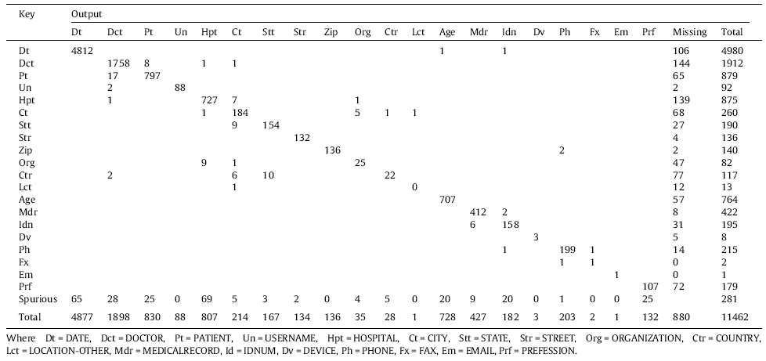
Error Analysis
Error Analysis
Notes:
17

Slide 18
Conclusions
Conclusions
Machine learning-based tagger
Supplemented with other techniques
Regular expressions
External dictionaries
Post-processing methods (e.g., co-reference)
Opportunities & Challenges
Improved performance
Domain specific (ML and regular expressions)
Leveraging structured data(?)

Slide 19
Thank you! Questions? Contact: Yizhao.Ni@cchmc.org
Notes:
19

